Slide 1
Unit-1
Basics of Algorithms and Mathematics

Slide 2
Introduction to Algorithms

Slide 3
What is an Algorithm?
An algorithm can be broadly defined as;
  A process or a set of rules to be followed to achieve desired output, especially by a computer.
  A step-by-step procedure, to solve the different kinds of problems.
  An unambiguous sequence of computational steps that transform the input into the output.
  An algorithm is any well-defined computational procedure that takes some value, or a set of values as input and produces some value, or a set of values as output.

Slide 4
Characteristics of an Algorithm
Precision: Each step of an algorithm must be precisely defined.
Input: An algorithm accepts zero or more inputs.
Output: An algorithm must generate at least one desirable output.
Finiteness: An algorithm must always terminate after a finite number of steps.
Effectiveness: All the operations to be performed in the algorithm must be essential and sufficiently basic.
Generality: The algorithm should be expressed in a generic form and must be applicable to a set of all possible inputs.

Slide 5
Types of Algorithm
Simple recursive algorithms
Backtracking algorithms
Divide and conquer algorithms
Dynamic programming algorithms
Greedy algorithms
Branch and bound algorithms
Brute force algorithms
Randomized algorithms

Slide 6
Mathematics for Algorithmic Sets

Slide 7
Set Theory
A set is an unordered collection of distinct objects.
The objects in a set are called elements or members of the set.
Example 1
$$Set A=\left\{11, 12, 21, 22\right\}$$
$$Set B=\left\{5, 10, 15, 20, 25\right\}$$
Roster Notation
Example 2
    $$Set C= \left\{x \right|x is an odd integer greater than 1\}$$
  $$Set D=\{x | x∈C and x≤11\}$$
    Set-builder Notation

Slide 8
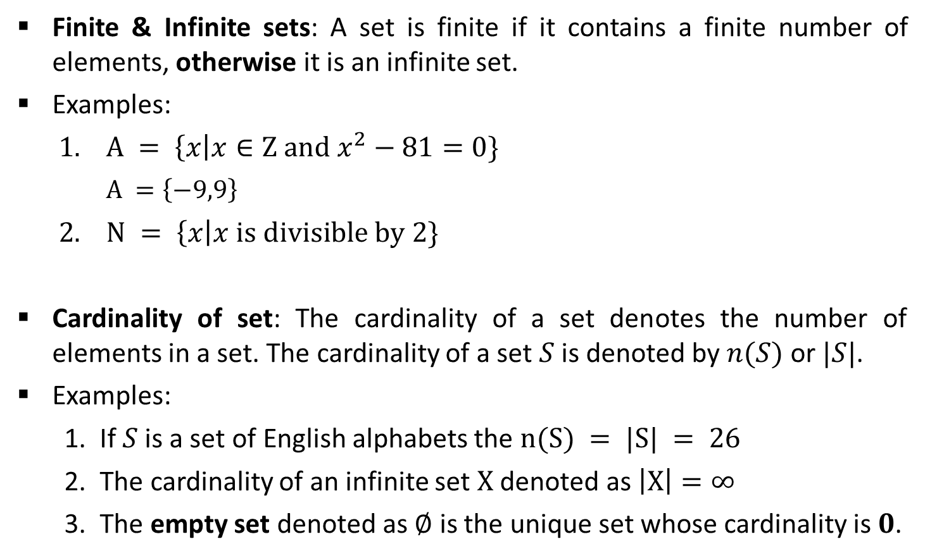
Set Theory
Finite & Infinite sets: A set is finite if it contains a finite number of elements, otherwise it is an infinite set.
Examples:
  $A = \left\{x\right|x∈Z and x^{2}−81=0\}$
    $$A =\left\{−9,9\right\}$$
  $N = \left\{x\right|x is divisible by 2\}$
Cardinality of set: The cardinality of a set denotes the number of elements in a set. The cardinality of a set $S$ is denoted by $n(S)$ or $|S|$.
Examples:
  If $S$ is a set of English alphabets the $n(S) = |S| = 26$
  The cardinality of an infinite set $X$ denoted as $\left|X\right|=∞$
  The empty set denoted as $∅$ is the unique set whose cardinality is $0$.
Finite Set
    Set $N$ is an infinite set

Slide 9
Set Theory
Subset: For two sets $A$ and $C$, we say that $C$ is a subset of $A$, written as $C⊆A$, if each member of set $C$ is also a member of set 𝐴.
Proper Subset: A proper subset of a set $A$ is a subset of $A$ that is not equal to $A.$
Example:
  If $A=\{1,3,5\}$and $B = \left\{1,5\right\},$ set $B$ is a proper subset of $A$.
  Set $C=\{1,3,5\}$is a subset of $A$, but it is not a proper subset of $A$ since $C=A$.
$$B\text{⊂}A$$
$$C⊆A$$
A
A=C
B

Slide 10
Set Theory
Power Set: Let $A$ be the set. The power set of $A$, written as $P(A)$, is the set of all subsets of $A$.
Example:
  $A= \{0, 1\}$then the power set of $A is \{\{\}, \{0\}, \{1\}, \{0, 1\}\}$

Slide 11

Set Theory
Complement: The complement of a set $A$ is the set $A’$ that contains every element of the Universal set U but not in A.
  $$A′ = \{x | x ∈U and x∉A\}$$
Example:
  Consider $U = \{1, 3, 5, 7, 9\}$and $A = \left\{1, 5\right\}$
  Then $A′= \{3, 7, 9\}$
A’
A
U

Slide 12

Set Operations
Union: The union of two different sets $A$ and $B$ is the set of all distinct elements of sets $A$ and $B$.
  $$A ∪ B = \{x | x ∈ A or x ∈ B\}$$
Example:
  Consider $A = \{1, 3, 5, 7, 9\}$and $B = \{1, 2, 3, 4, 5\}$
    Then $A ∪ B = \{1, 2, 3, 4, 5, 7, 9\}$
A
B
A
B

Slide 13
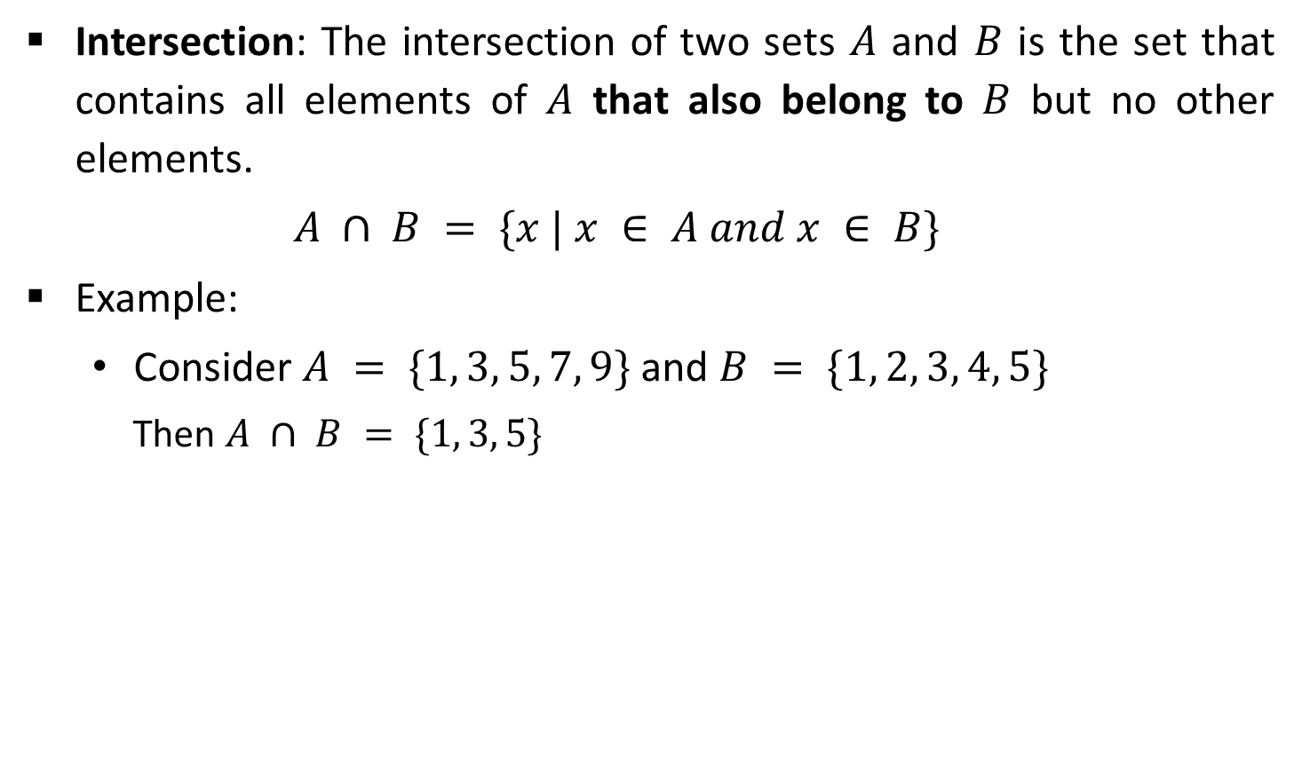
Set Operations
Intersection: The intersection of two sets $A$ and $B$ is the set that contains all elements of $A$ that also belong to $B$ but no other elements.
  $$A ∩ B = \{x | x ∈ A and x ∈ B\}$$
Example:
  Consider $A = \{1, 3, 5, 7, 9\}$and $B = \{1, 2, 3, 4, 5\}$
    Then $A ∩ B = \{1, 3, 5\}$
A
B

Slide 14
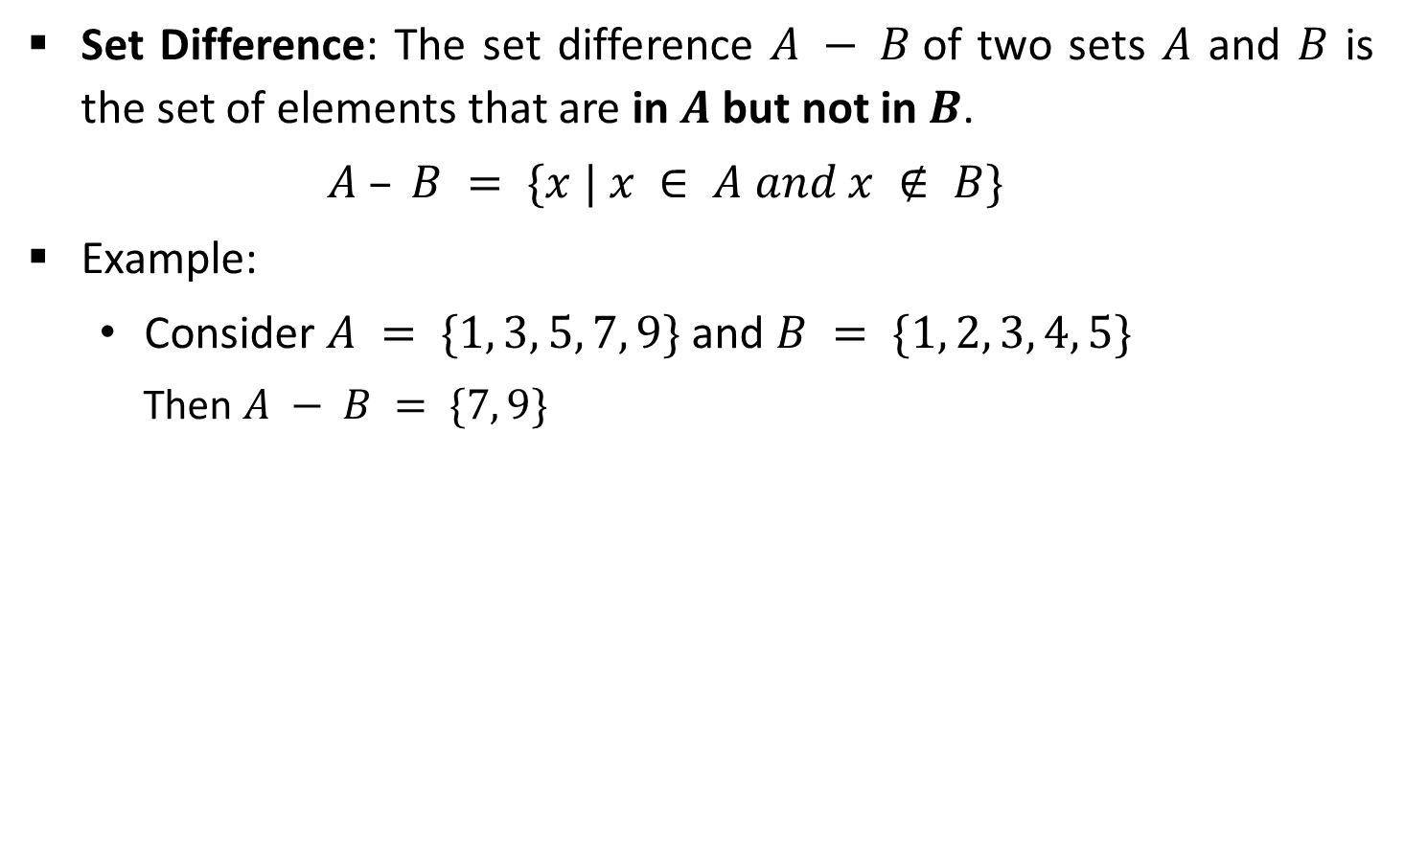
Set Operations
Set Difference: The set difference $A − B$of two sets $A$ and $B$ is the set of elements that are in $A$ but not in $B$.
  $$A – B = \{x | x ∈ A and x ∉ B\}$$
Example:
  Consider $A = \{1, 3, 5, 7, 9\}$and $B = \{1, 2, 3, 4, 5\}$
    Then $A − B = \{7, 9\}$
A
A
B

Slide 15

Set Operations
Symmetric Difference: The symmetric difference $A ⊖ B$ of two sets $A$ and $B$ is the set of elements that are in $A$ but not in $B$ and the elements that are in $B$ but not in $A$.
  $$A ⊖ B = (A – B) ∪(B – A)$$
Example:
  Consider, $A = \{1, 3, 5, 7, 9\}$and $B = \{1, 2, 3, 4, 5\}$
    Then $A ⊖ B = \{7, 9, 2, 4\}$
A
A
B
B

Slide 16
Set Operations
Sequences: A sequence of objects is a list of objects in some order.
Example: the sequence 7, 21, 57 would be written as (7, 21, 57)
In a set the order does not matter but in a sequence it does.
Repetition is not permitted in a set but repetition is permitted in a sequence. So, (7, 7, 21, 57) is different from (7, 21, 57).
Tuples: Finite sequences are called tuples.
Examples:
  (7, 21) 2-tuple or pair
  (7, 21, 57) 3-tuple
  (7, 21, ..., k ) k-tuple

Slide 17










Set Operations
Cartesian Product: The Cartesian product $A × B$ of two sets $A$ and $B$ is the set of all ordered pairs $(a, b)$where $a∈A$and $b∈B$.
  $$A×B = \{(a, b) | a ∈ A and b ∈ B\}$$
Example:
$$(1, x)$$
$$(1, y)$$
$$A= \{1, 2, 3\}$$
$$(2, x)$$
$$(2, y)$$
$$B=\{x, y\}$$
$$(3, x)$$
$$(3, y)$$
$$A×B$$

Slide 18
Relation
Let $A$ and $B$ be two sets. Any subset $R$ of their Cartesian product $A×B$is a relation.
A relation defines the relationship between sets of values.
It is defined between the x-values and y-values of the ordered pairs.
The set of all x-values is called the domain, and the set of all y-values is called the range.

Slide 19
Properties of the Relation
Reflexive: Let $A$ be a set, and let $R$ be a binary relation on $A$. Relation $R$ is reflexive if,
$∀x:[(x∈A)→((x, x)∈R)]$
Examples:
Example 1
Example 2
$A=\{1, 2\}$and
$$R=\{(a,b) | a≤b\}$$
So,
$$R=\left\{\left(1,1\right), \left(1,2\right), \left(2,2\right)\right\}$$
    $$A = \left\{1,2,3\right\} and$$
    $$R=\{(1,1), (1,2), (3,1), (2,2)\}$$
Reflexive
Not Reflexive
    since $(3,3) ∉ R$

Slide 20
Properties of the Relation
Symmetric: A relation $R$ on a set $A$ is called symmetric if $(y, x)∈R$whenever $(x, y)∈R$, for some $x, y∈A$.
$$∀x:∀y:[((x, y)∈R)→((y, x)∈R)]$$
Examples:
Example 1
  $$A=\{1,2,3\} \text{and} R=\{(a,b)|a≠b\} \\ \text{So}\text{, }R=\{(1,2),(1,3),(2,1),(2,3),(3,1),(3,2)\}$$
Symmetric
Example 2
  $A = \{ 1, 2, 3\}$and $R = \{(a,b) | a ≤ b\}$
  So, $R = \{(1,1), (1,2), (1,3), (2,2),(2,3),(3,3)\}$
    Asymmetric

Slide 21

Properties of the Relation
Transitive: A relation 𝑅 on a set 𝐴, is called transitive if whenever (𝑥,𝑦)∈𝑅 and (𝑦,𝑧)∈𝑅, then (𝑥,𝑧)∈𝑅, for 𝑥, 𝑦, 𝑧∈𝐴.
$$∀x:∀y:∀z[([(x, y)∈R]∧[(y, z)∈R])→((x, z) ∈ R)]$$
Examples:
Example 1
  $$A=\{ 1, 2, 3\} and R=\{(a,b) | a ≤ b\}$$
  $$So, R=\{(1,1), (1,2), (1,3), (2,2),(2,3),(3,3)\}$$
Transitive

Slide 22
Equivalence Relation
Equivalence Relation declares or shows some kind of equality or equivalence.
If the relation satisfies all three properties reflexive, symmetric and transitive then it is called an Equivalence Relation.
Equality ‘=’ relation is the equivalence relation because equality proves the required conditions.
  Reflexive: $x=x$ is true for all values of $x$.
  Symmetric: $x=y$ and $y=x$ is true for all values of $x$ and $y$.
  Transitive: if $x=y$ and $y=z$ is true for all values then we can say that $x=z$.

Slide 23

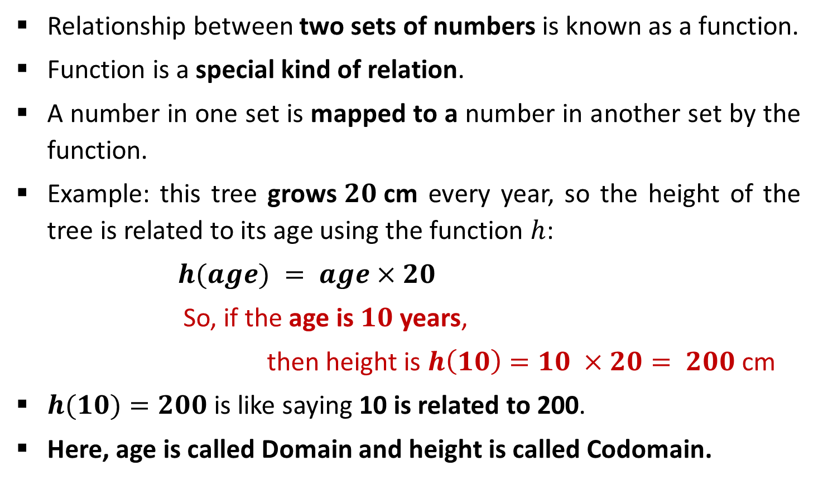
Functions
Relationship between two sets of numbers is known as a function.
Function is a special kind of relation.
A number in one set is mapped to a number in another set by the function.
Example: this tree grows$20$cm every year, so the height of the tree is related to its age using the function $h$:
$$h(age) = age×20$$
So, if the age is $10$ years,
then height is $h\left(10\right)=10 ×20= 200$cm
$h(10)=200$is like saying 10 is related to 200.
Here, age is called Domain and height is called Codomain.

Slide 24
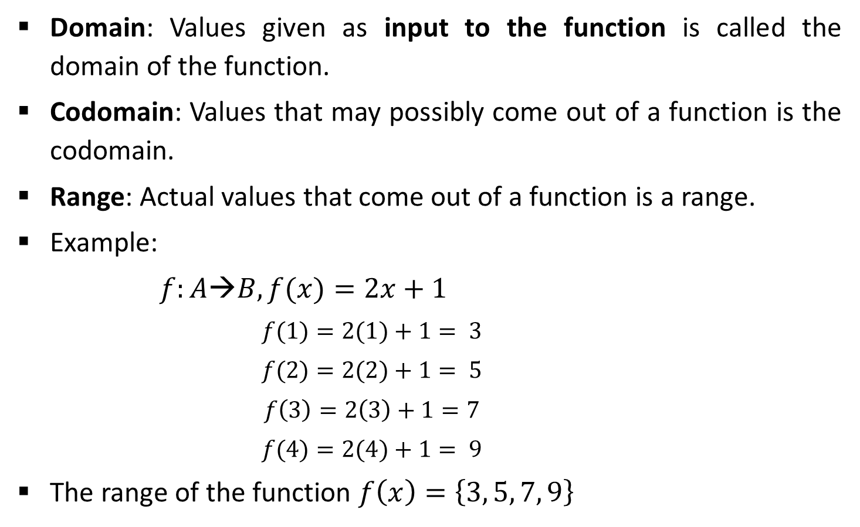
Function Notations
Domain: Values given as input to the function is called the domain of the function.
Codomain: Values that may possibly come out of a function is the codomain.
Range: Actual values that come out of a function is a range.
Example:
  $$f:A→B, f(x)=2x+1$$
    $$f(1)=2(1)+1= 3$$
    $$f(2)=2(2)+1= 5$$
    $$f\left(3\right)=2\left(3\right)+1=7$$
    $$f(4)=2(4)+1= 9$$
The range of the function $f\left(x\right)=\left\{3, 5, 7, 9\right\}$
Codomain
$$1$$
2
3
4
5
6
7
8
9
10
$$1$$
Domain
$$2$$
$$3$$
$$4$$
Domain
Codomain

Slide 25
Relation & Function
Relation 1
Relation 2
Is not a function since elements of domain point to multiple elements of codomain.
Is a function since elements of domain point to only one element of codomain.
Ana
Mit
Sam
Yug
Jen
Tom
Ram
Neel
CX
CY
CZ
Ana
Yug
Ram
Mit
CX
CY
CZ
Division (Domain)
Students (Codomain)
Students (Domain)
Division (Codomain)

Slide 26
Functions
If the range of function and codomain of function are equal then the function is said to be onto or surjective or surjection.
Example:
  $f:A→B$, $f\left(x\right)= x2$
    where $A=\{−2,−1,1,2,3,4\}$and $B=\{1,4,9,16\}$
      $$f\left(−2\right)=4,$$
      $$f\left(−1\right)=1,$$
      $$f\left(1\right)=1,$$
      $$f\left(2\right)=4,$$
      $$f\left(3\right)=9,$$
      $$f(4)=16$$
Range of function $f(x)=\{1, 4, 9, 16\}=B$
Codomain
$$A$$
-$2$
$$B$$
-$1$
$$1$$
$$1$$
$$4$$
$$2$$
$$9$$
$$3$$
$$4$$
$$16$$

Slide 27
Functions
A function $f:A→B$is injective or one-to-one if there do not exist two distinct $x1$and$x2$such that $f(x1)=f(x2).$
The function $f:A →B$, $f(x)=x+1$is a one-to-one function,
    where $A=\{1, 2, 3, 4\}$and $B=\{2, 3, 4, 5\}$
$$1$$
$$2$$
$$2$$
$$3$$
$$3$$
$$4$$
$$4$$
$$5$$
$$A$$
$$B$$

Slide 28
Functions
If function is both one-to-one and onto then the function is called Bijection function.
Example:
  function $f :A→B, f(x)= x^{2}$
    where $A=\{1,2,3,4\}$and $B=\{1,4,9,16\}$
    $$f(1) = 1$$
    $$f(2) = 4$$
    $$f(3) = 9$$
    $$f(4) = 16$$
$$A$$
$$B$$
1
1
2
4
3
9
16
4

Slide 29
Vectors and Matrices
A vector, $u$, means a list (or $n$-tuple) of numbers:
  Where$u_{i}$are called the components of $u$.
  If all the $u_{i}$ are zero, then $u$ is called the zero vector.
Vector operations : Addition, Subtraction, Scalar Multiplication
Matrix A, means a rectangular array of numbers.
3x3 Matrix$: \left[\begin{matrix}1 & 2 & 3 \\ 4 & 5 & 6 \\ 7 & 8 & 9\end{matrix}\right]$
Matrix operations: Addition, Subtraction, Multiplication
  $$u = (u_{1}, u_{2}, . . . , u_{n})$$

Slide 30
Linear Inequalities
Inequalities: The term inequality is applied to any statement involving one of the symbols <, >, ≤, ≥.
Examples of inequalities are:
  $x≥1$
  $x + y + 2z > 16$
  $p2 + q2 ≤1/2$
  $a2 + ab > 1$

Slide 31
Linear Equations
Linear equation with one Unknown
Two Equations with Two Unknowns
  A system of two linear equations in the two unknowns $x$ and $y$ is
$$a_{1}x + b_{1}y = c_{1}$$
$$a_{2}x + b_{2}y = c_{2}$$
  The solution of above can be obtained by the elimination process, whereby reduce the system to a single equation in only one unknown.
$$x=\frac{b}{a}$$
$$ax = b$$
Solution

Slide 32
Logic
Declarative statement that is sufficiently objective, meaningful and precise to have a truth value (true or false) is known as proposition.
Proposition examples:
  $p$ : Fourteen is an even integer.
  $q$ : Mumbai is the capital city of India.
  $r$ : 0 = 0
Following statements are not propositions.
  Close the door.
  Where are you?
  $x$ is greater than $5$.

Slide 33
Logical Connectives
Conjunction ($\text{Ʌ}$): The logical connective Conjunction (logical AND) is true only when both of the propositions are true.
Example:
  $p$ : It is raining
    $q$ : It is cold
    $r$ : It is raining AND it is cold
Truth table
$$p$$ | $$q$$ | $r$ = $p \text{Ʌ} q$
$$True$$ | $$True$$
$$True$$ | $$False$$
$$False$$ | $$True$$
$$False$$ | $$False$$
$$True$$
$$False$$
$$False$$
$$False$$

Slide 34
Logical Connectives
Disjunction (V): The logical disjunction, or logical OR, is true if one or both of the propositions are true.
Example:
  $$p : 2+2=5$$
    $$q : 1<2$$
    $$r : 2+2=5 OR 1<2$$
Truth table
$$p$$ | $$q$$ | $r$ = $p$ V $q$
$$True$$ | $$True$$
$$True$$ | $$False$$
$$False$$ | $$True$$
$$False$$ | $$False$$
$$True$$
$$True$$
$$True$$
$$False$$

Slide 35
Logical Connectives
Negation (¬): $➢p$, the negation of a proposition $p$, is also a proposition.
Example:
  $p$ : John studies.
    $➢ p$ : John does NOT study.
Truth table
$$p$$ | $$➢ p$$
$$True$$
$$False$$
$$False$$
$$True$$

Slide 36
Logical Quantifiers
Universal Quantifier (denoted as $“∀”$ for all): $P(a)$ is the preposition, if $P(a)$gives expected result for all values of $a$ in the universe of discourse then the universal quantification of $P(a)$ is denoted by, $∀a P(a).$
Examples:
  $∀x : P\left(x\right),$ for all values of $x, P(x)$is true
  $$∀x : P(x)=x+1> x$$
In order to prove that a universal quantification is false, it must be shown to be false for only ONE case.
In order to prove that a universal quantification is true, it must be shown true for ALL cases.

Slide 37
Logical Quantifiers
Existential Quantifier (denoted as $“”$ for some): $P(a)$is the preposition, if there exits an element $a$ in the universe of discourse such that $P(a)$is giving expected result then the Existential Quantification of $P(a)$ is represented by, $∃a P(a).$
Example:
  Let $P(x) = x/2 < x$
    There exists a numerical value for which $x/2 < x$is true
    Thus, $ x : P(x)$is true
In order to show an existential quantification is true, it must be shown true for only ONE value.
In order to show an existential quantification is false, it must be show false for ALL values.

Slide 38
Assignment - 1
Define Algorithm. How algorithm differs from flow chart?
What is vector? Which operations are performed on vector?
List types of algorithms.
Discuss key characteristics of algorithm.

